Slide 1
F20S53 step3 temp.3 abort

Slide 2
Discipline 1. 選定團隊 Form the Team
S210
S220

Slide 3
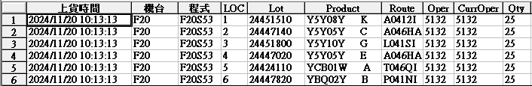
Discipline 2.描述問題及現況掌握Describe the Problem
(WHO detected the problem? WHAT is wrong? State the problem in terms of object and defect. WHERE the problem was first detected, describe location of the detection, lot #, WHEN and HOW it was detected)
What | F20 run S53 step.3 temp.3 abort=848°C (set=901°C)
Where | F20
When | 2024.11.20
Extent | Total impact : 6 lot / 150 pcs

Slide 4
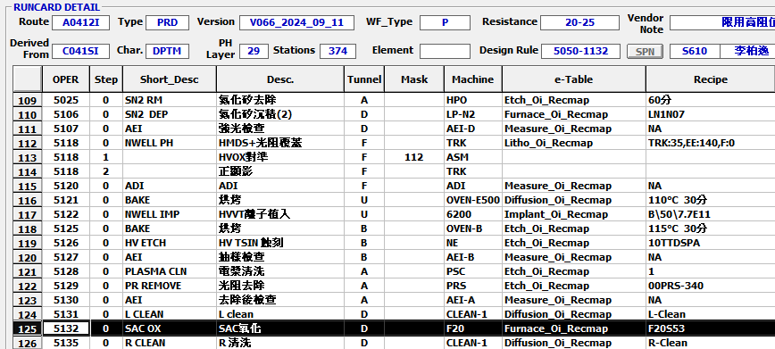
Run cards at impact station
A0412I<5132>

Slide 5
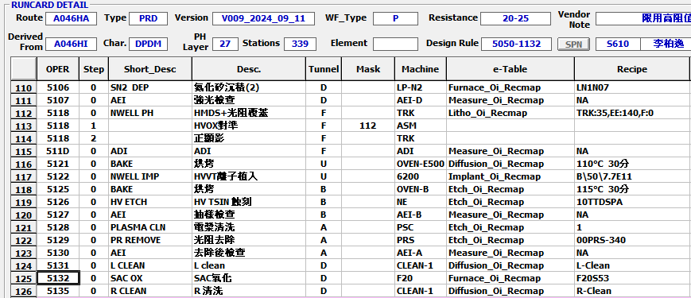
Run cards at impact station
將有問題的站點前後 run cards 貼上
A046HA<5132>

Slide 6
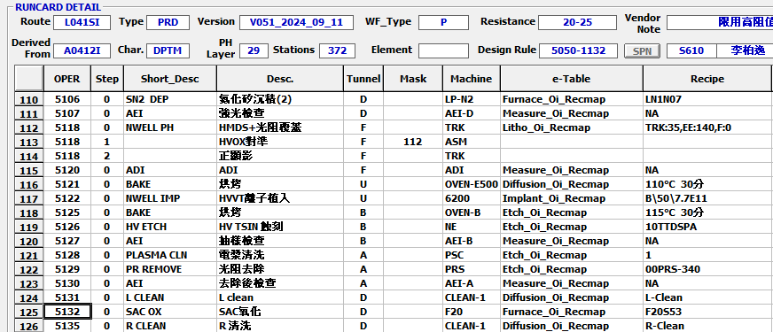
Run cards at impact station
將有問題的站點前後 run cards 貼上
L041SI<5132>

Slide 7
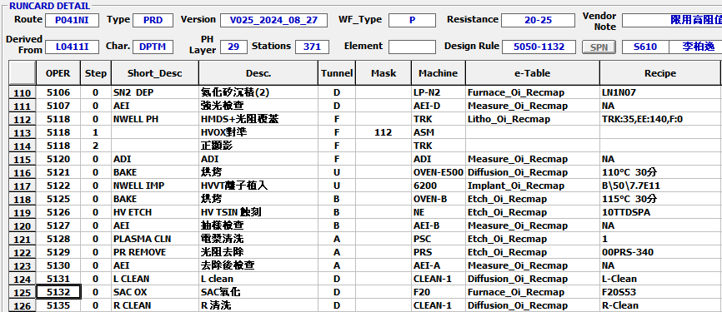
Run cards at impact station
將有問題的站點前後 run cards 貼上
P041NI<5132>

Slide 8
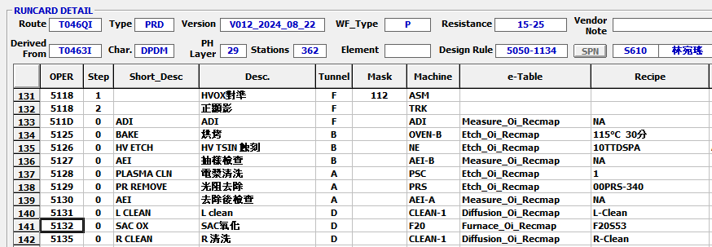
Run cards at impact station
將有問題的站點前後 run cards 貼上
T046QI<5132>

Slide 9
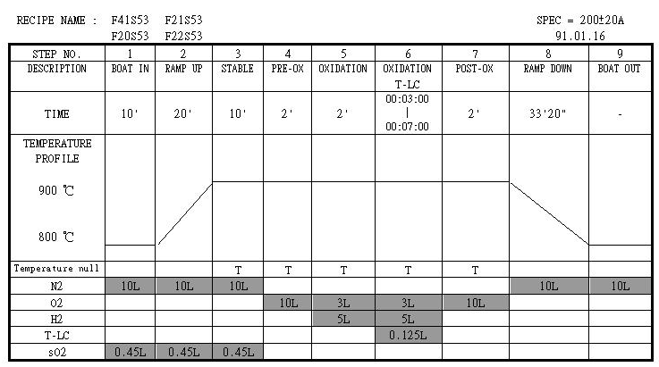
Discipline 2.描述問題及現況掌握Describe the Problem
(WHO detected the problem? WHAT is wrong? State the problem in terms of object and defect. WHERE the problem was first detected, describe location of the detection, lot #, WHEN and HOW it was detected)
S53 程式內容:
Step.3 temp.3 abort
Abort 步驟

Slide 10
Discipline 2.描述問題及現況掌握Describe the Problem
(WHO detected the problem? WHAT is wrong? State the problem in terms of object and defect. WHERE the problem was first detected, describe location of the detection, lot #, WHEN and HOW it was detected)
Step.3 temp set=901 , actual = 848C, alarm set:15度/60sec
溫度設定值
溫度實際值

Slide 11
Discipline 2.描述問題及現況掌握Describe the Problem
(WHO detected the problem? WHAT is wrong? State the problem in terms of object and defect. WHERE the problem was first detected, describe location of the detection, lot #, WHEN and HOW it was detected)
Check RMS 流量正常
流量設定值
流量實際值

Slide 12

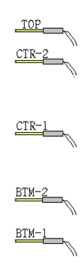
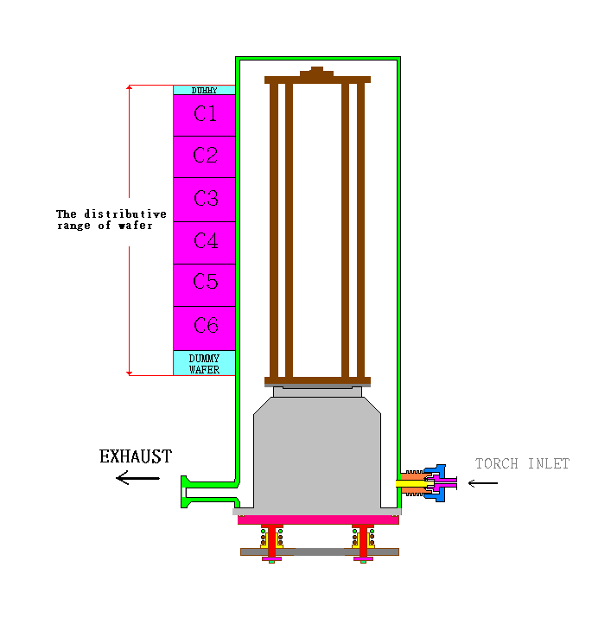
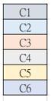
Discipline 2.描述問題及現況掌握Describe the Problem
(WHO detected the problem? WHAT is wrong? State the problem in terms of object and defect. WHERE the problem was first detected, describe location of the detection, lot #, WHEN and HOW it was detected)
Heater Spike T/C 與 Boat Wafer 相對應位置
Boat D/W: 8pcs
012
C1 M/W:09
170片
078
C4 M/W:86
152
C6 M/W:161
Boat D/W: 9pcs

Slide 13
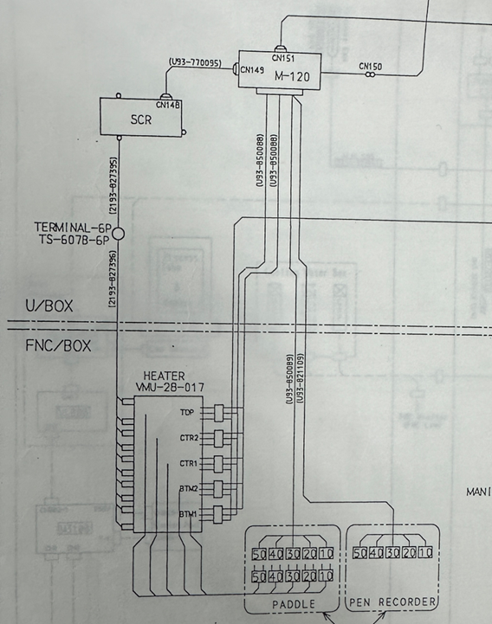
Discipline 2.描述問題及現況掌握Describe the Problem
(WHO detected the problem? WHAT is wrong? State the problem in terms of object and defect. WHERE the problem was first detected, describe location of the detection, lot #, WHEN and HOW it was detected)
目視PCB 零件無焦黑破損
更換SCR(矽控整流器) PCB
CENTER-1

Slide 14
Discipline 2.描述問題及現況掌握Describe the Problem
(WHO detected the problem? WHAT is wrong? State the problem in terms of object and defect. WHERE the problem was first detected, describe location of the detection, lot #, WHEN and HOW it was detected)
測試*3 溫度正常
溫度異常真因 : 疑SCR PCB造成

Slide 15
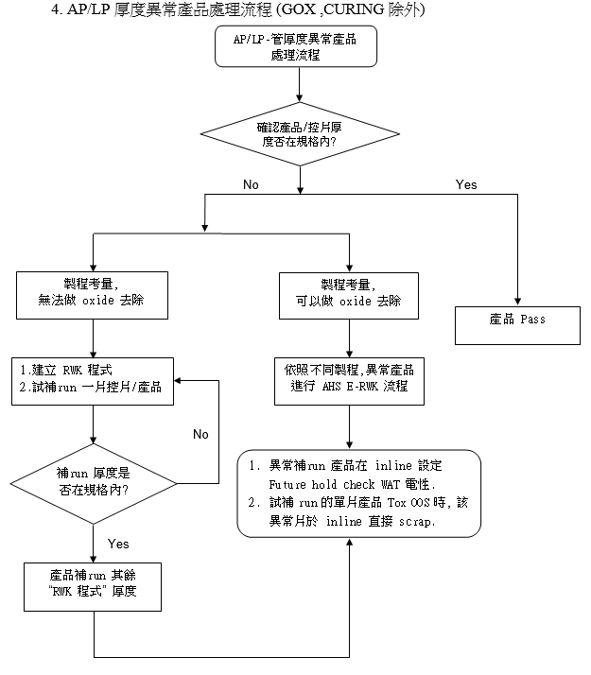
OCAP

Slide 16
Discipline 3.執行及驗證暫時防堵對策 Contain the Problem
(Define and implement containment actions to isolate the effect of problem from any internal/external customer until corrective action is implemented)
F20 run S53 step3 temp.3 abort
Check: C1/C4/C6 產品:18.6/16.1/16.0
Action:
請日班follow 建立RWK程式補run C4 #1 then check THK

Slide 17
Summary
F20 Run S53 step.3 temp.3 abort
產品處理:
1. Check: C1/C4/C6 MW:18.6/16.1/16.0 2.請日班follow 建立RWK程式補run then check THK
機台處理 :
1. 更換SCR (矽控整流器) PCB , 測試溫度*3 正常

Slide 18
EDC & RTC
控片及產品之 EDC & RTC data (trends)/比較異常事件中的資料與正常資料

Slide 19
Discipline 3.執行及驗證暫時防堵對策 Contain the Problem
(Define and implement containment actions to isolate the effect of problem from any internal/external customer until corrective action is implemented)
3.1 異常產品 (Defect Lots)
項目 Item | 處理方式 Action | 負責人員 Resp | 預定完成日 Due | 實際完成日 Imp. | 處理結果 Verification
NA
3.2 波及產品 (Impact Lots)
項目 Item | 處理方式 Action | 負責人員 Resp | 預定完成日 Due | 實際完成日 Imp. | 處理結果 Verification

Slide 20
Discipline 3.執行及驗證暫時防堵對策 Contain the Problem
(Define and implement containment actions to isolate the effect of problem from any internal/external customer until corrective action is implemented)
3.3 波及設備 (Impact Machine)
項目 Item | 處理方式 Action | 負責人員 Resp | 預定完成日 Due | 實際完成日 Imp. | 處理結果 Verification
F24
3.4 波及製程 (Impact Route) : 是(YES)/否(No)
項目 Item | 處理方式 Action | 負責人員 Resp | 預定完成日 Due | 實際完成日 Imp. | 處理結果 Verification
No | No | No | No | No | No
3.5 產品召回選項，是否需進行客戶端波及產品的召回?是(YES)/否(No)
Customer | Product No. | Lot number / Wafer number | Approx. Quantity
No | No | No | No

Slide 21
Summary

Slide 22
Discipline 4.定義及驗證真因 (Identify the Root Cause)
(Identify all potential causes which could explain why the problem occurred)
4.1 Non-conformance root cause (defect nature / technical root cause):
b) 列出所有可能的原因 (Probable Causes/Factors): Non-conformance
工具 (Tools): 故障樹分析 (Fault Tree Analysis)、魚骨圖 (Fishbone)

Slide 23
Discipline 4.定義及驗證真因 (Identify the Root Cause)
(Identify all potential causes which could explain why the problem occurred)
4.1 Non-conformance root cause (defect nature / technical root cause):
c) 真因驗證 (Root Cause Verification)

Slide 24
Discipline 4.定義及驗證真因 (Identify the Root Cause)
(Identify all potential causes which could explain why the problem occurred)
4.1 Non-conformance root cause (defect nature / technical root cause):
d) 5-Why analysis
b) Conclusion :

Slide 25
Discipline 4.定義及驗證真因 (Identify the Root Cause)
(Identify all potential causes which could explain why the problem occurred)
4.2 Non-detection / escape root cause (Provide reason to why the current system failed to detect)
a) 5-why:
b) Conclusion

Slide 26
Discipline 5.擬定及驗證永久改善對策Choose and verify permanent corrective action (列出各項執行之對策並檢核其對策有效性)
5.1 What was the chosen corrective action to correct the root cause? (Add photo or diagram where applicable.)
Short term :
Long term:

Slide 27
Discipline 5.擬定及驗證永久改善對策Choose and verify permanent corrective action (列出各項執行之對策並檢核其對策有效性)
5.1 What was the chosen corrective action to correct the root cause? (Add photo or diagram where applicable.)

Slide 28
Discipline 5.擬定及驗證永久改善對策Choose and verify permanent corrective action (列出各項執行之對策並檢核其對策有效性)
5.2 Verification of actions effectiveness

Slide 29
Discipline 5.擬定及驗證永久改善對策Choose and verify permanent corrective action (列出各項執行之對策並檢核其對策有效性)
5.2 Verification of actions effectiveness

Slide 30
Discipline 6.實施認永久改善對策Corrective Actions Implementation
6.1 For non-conformance root cause (defect nature / technical root cause):
6.2 For non-detection / escape root cause

Slide 31
Discipline 7.避免再發Prevent Recurrence (Modify System / Document)
7.1 Systemic Actions:

Slide 32
Discipline 7.避免再發Prevent Recurrence (Modify System / Document)

Slide 33
Discipline 7.避免再發Prevent Recurrence (Modify System / Document)
7.2 Corrective Actions Fan-out: (水平展開):

Slide 34
Discipline 8. Congratulate the Team
Thanks for every member helped in this case.
Reviewed and Approved by:

